Slide 1
Defining a PLM Business Case to Gain Executive Support
Jeff Pohl, Product Development, Deloitte Consulting LLP
June 4th, 2015

Slide 2
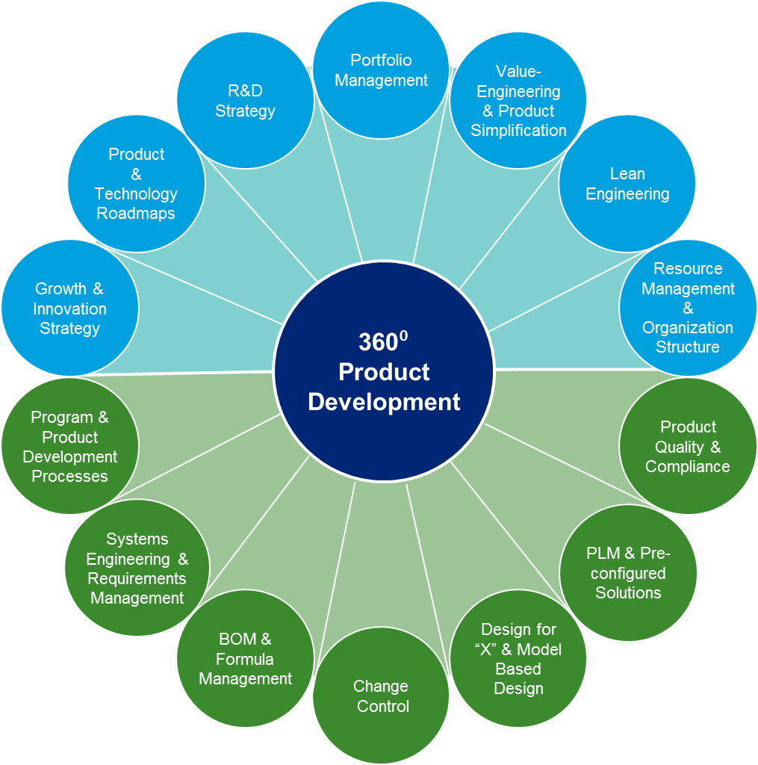
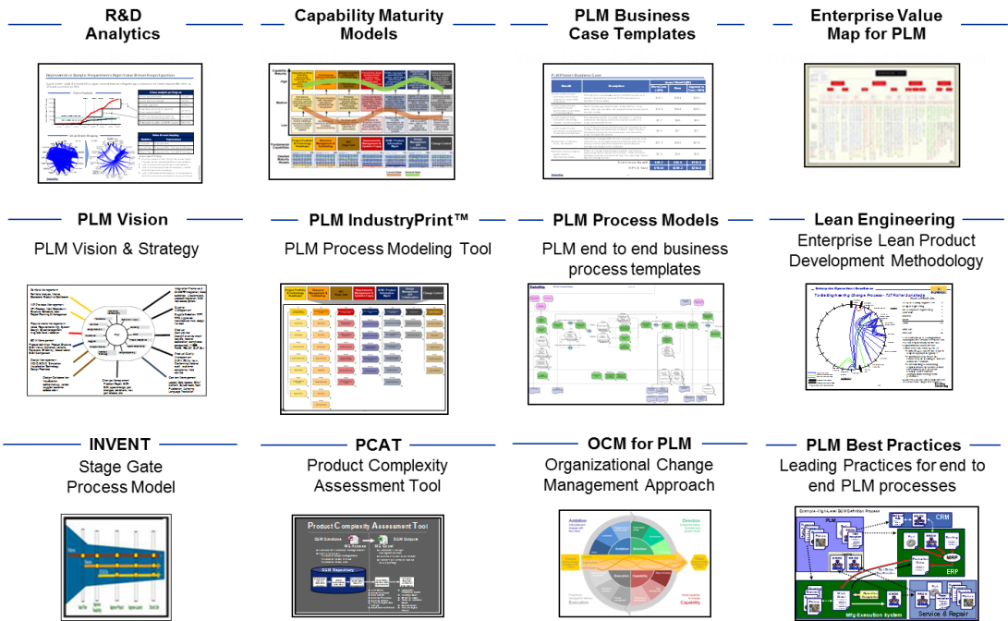
Deloitte’s Lean Engineering & PLM Services
Deloitte Consulting offers 360º services to address our clients’ strategic and operational challenges in product development
Our Services
Our Tools & Accelerators

Slide 3
Major challenges facing the industry
Major challenges
Factors
R&D spend as a percentage of revenue has been falling this decade after consistent growth in the last century
Executives question the return on their investments from engineering organizations
Declining Engineering Budgets
Engineering capacity requirements continues to grow across industries, e.g. Aerospace, Automotive, etc.
Required engineering skills for new processes and tools not available
Deeply skilled Engineers are retiring and new talent is hard to find
Increased leverage of external service providers
Limited Engineering
capacity
Increasing
complexity in
Engineering
Increasing amount of electronics and software
Shorter lead times and development cycles
Focus on innovation with new technologies, materials, etc
Multiple interface
integrations
Growing network of interactions with internal and external parties (customers, partners, suppliers, matrix organization)
Concurrent development programs and a Lack of early cross-functional involvement
Unstable input and
shifting time frames
Delay of input data from customer e.g. product definition
Shifting schedules from program partners
Increasing complexity of interactions with Manufacturing

Slide 4
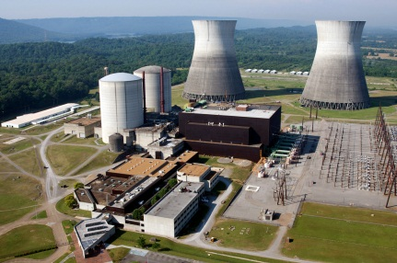


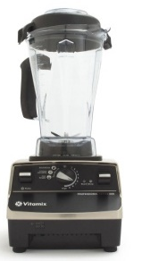
Our Lean Engineering transformation capabilities have proven to be effective for a wide spectrum of clients with varying product complexity
Highly Engineered Products and Construction
Engineered to Order Products
Configured to Order Products
Build to Stock Products
GE Power Plant
Westinghouse Nuclear
Lockheed Space
Bell Helicopter
SpiritAero Systems
GE Turbines
Cobham
Marvin Engineering
Caterpillar
Nissan
JCI Auto Interiors
Pratt and Whitney Canada
Vitamix (Kitchen Appliances)
MTD (Lawn Mowers and Garden Equips)
Revlon
Coke
Monster Cable
Our Lean Engineering transformation approach focuses on addressing gaps in Process, Technology, and Org Design to free up between 15-30% engineering capacity

Slide 5
Our Overall Approach

Slide 6
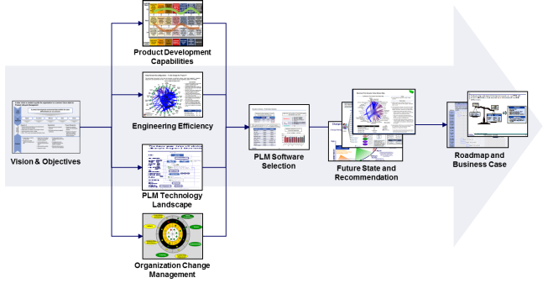
The Assessment Phase
  The Assessment quickly identifies the areas most critical to improving performance
Change Imperative
Finalize Scope
Deploy
Weeks
Months, Not Years
Assess
Improve
Identify the critical areas for improving performance and develop roadmap
Define and deploy specific improvements across people, process and technology
Engineering Strategy
Improve the engineering strategy and operating model; innovation and growth strategy
Operational Excellence
Lean business processes and aligned roles, and responsibilities across product areas and functions
Organization and Talent
Bolster the operational structure, governance, competencies, skills, and talent
PLM
Technology
Improve quality and traceability of information. Integrate execution to improve flow across silos
Our transformation approach has helped numerous clients reduce time-to-market, improve engineering efficiency, and increase profitability

Slide 7
Approach – Assessment Phase

Slide 8
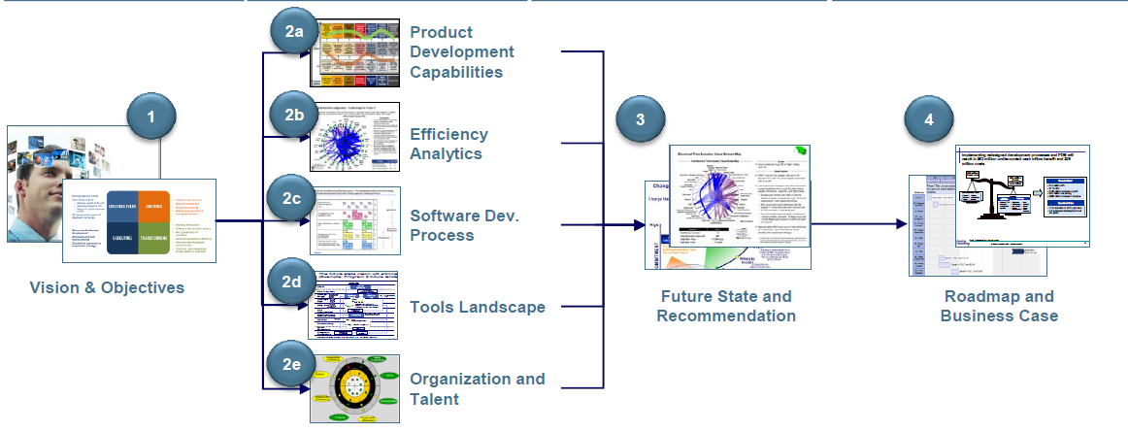
Engineering Transformation Strategy Assessment
  Our 6-12 week assessment involves a rapid but integrated assessment of engineering processes, tools, organization and talent related barriers
Step 1
Vision & Objectives
Step 2
Assess Current State
Step 3
Define Future State
Step 4
Build Implementation Roadmap and Business Case

Slide 9
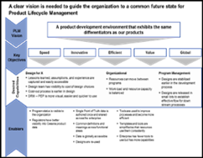
Step 1: Future Vision & Objectives
  Developing a business case requires a clear understanding of the overall vision, objectives and goals. A Detailed vision and objectives form the foundation to guide the development of the roadmap and supporting business case
Future state vision & objectives
Future Vision & Objectives
  Use enterprise-wide systems to strategically drive global common business processes using global common data
Lean Eng Project Objectives
  The Lean Engineering Assessment project shall achieve the following goals :
  Significantly improve the effectiveness and efficiency of engineering capabilities
  Strengthen global delivery by integrating the core processes and organization that is cost effective and caters to dynamics of footprint and budget
  Accelerate development of skills and hiring plans based on identified core competencies
  Provide the right information, at the right time, for the right people
  Integrate the extended enterprise’s information resources
Activities associated with this phase
Review the future vision, goals and objectives
Review project objectives and goals
Identify the projects, processes and data for the assessment
On-board resources to participate in the assessment
Deliverables
Deloitte’s perspective of the future vision and objectives
Select appropriate recent projects for value stream and capability analyses

Slide 10
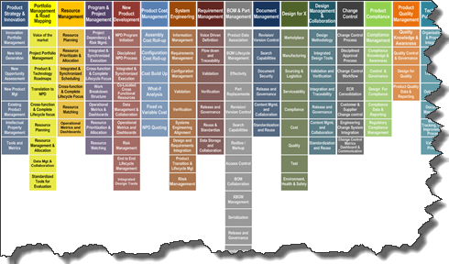
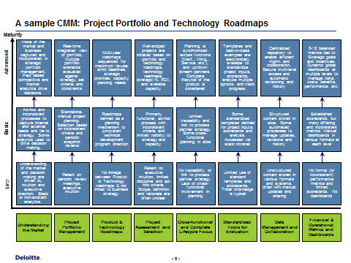
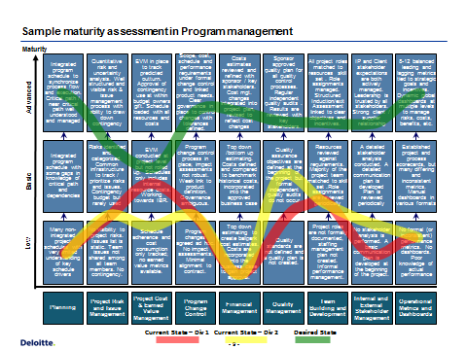
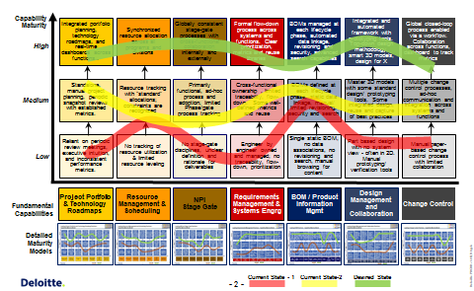
Step 2a: Assess Current State Capabilities
  We evaluate the current state of each of the core capabilities, benchmark against best-in-class and identify the root causes of inefficiency
20+ core capabilities identified with best-in-class assessment
Current state assessment for each of the core capabilities
Future state maturity goal
Activities associated with this phase
Conduct current state assessment workshops and interviews to perform qualitative process maturity assessment of core capabilities
Identify root cause of process inefficiencies
Deliverables
Core Capabilities - Current state qualitative assessment & future state maturity goal

Slide 11
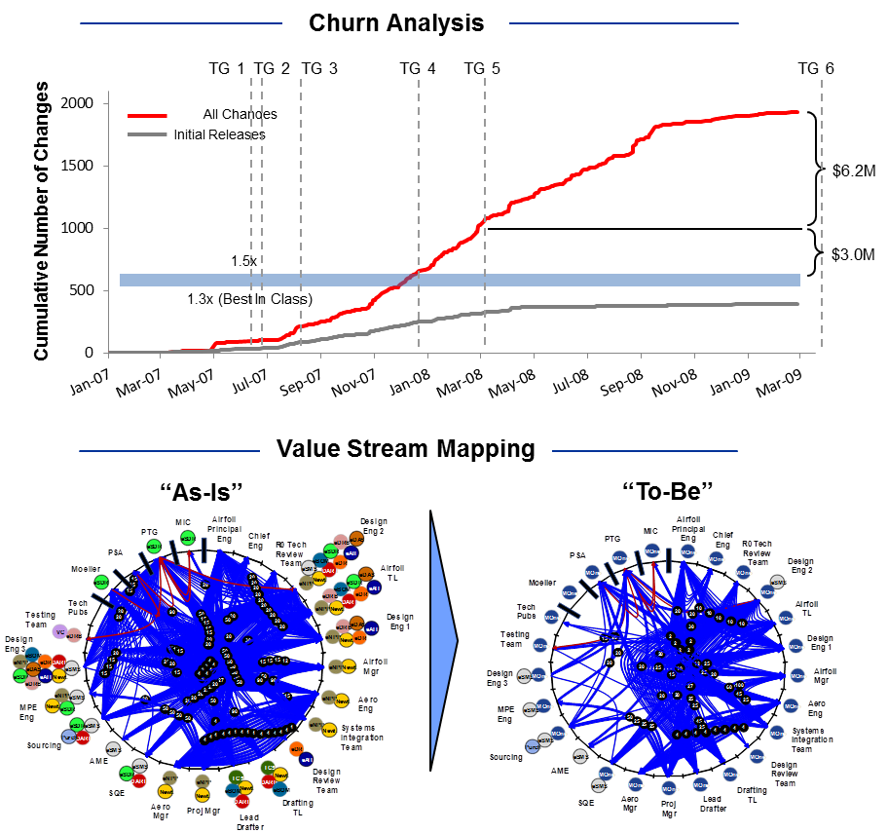
Step 2b: Engineering Efficiency (Quantitative)
  The engineering churn analysis depicts the magnitude of “as is” inefficiencies
Engineering Efficiency Analytics
Actual resource allocation and change data for representative program(s) is used to determine the magnitude of inefficiency in the current state
A representative component or sub-system is assessed using our Lean Value Stream mapping tool to identify the root causes of inefficiencies
Typically utilizing reconfigured processes can reduce churn in development, and free up 10-20% of the engineering capacity.
Activities associated with this phase
Identify projects and processes for the efficiency assessment
Collect actual data on exact electronic and physical flow of information during the part’s design process
Conduct churn and manpower analysis
Generate value stream map and churn report to identify root causes of engineering inefficiencies
Deliverables
Value stream maps and supporting analysis & Engineering churn analysis
Documented root causes of inefficiencies as identified by the value stream mapping and churn analysis
Identify magnitude of inefficiency in the current state

Slide 12
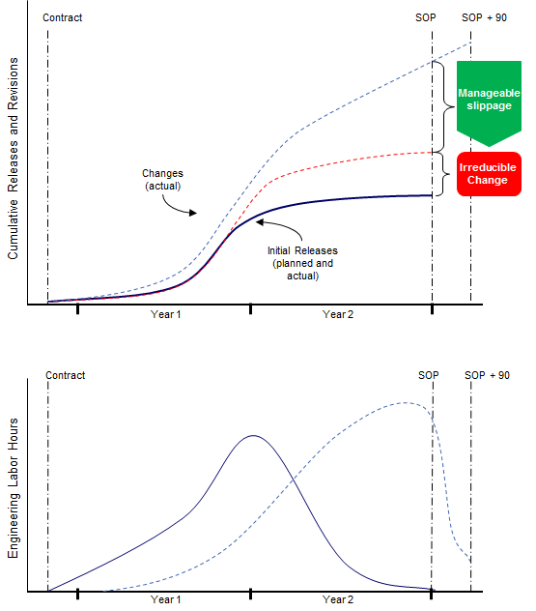
Step 2b: We perform deep fact based analytics. One Example: Engineering Churn Analysis
  Churn caused by unnecessary rework and change can be reduced through practical improvements to engineering processes and tools. To understand the root cause of churn, engineering changes and resource data need to be analyzed:
  Managing Churn
ILLUSTRATIVE
Typically, churn in core product development processes is caused by limitations in:
  Management and planning
  Design processes and disciplines
  Design tools and systems
Chief among these causes are unexpected content
growth and poorly coordinated or late design changes
Churn can often be managed via adjustments to
existing processes and systems coupled with leadership
recognition of it as a major competitive issue
Engineering Resources
ILLUSTRATIVE
Design resource consumption patterns can also reveal
churn (and quality risks) as designs are reworked to
completion

Slide 13
Step 2b: Another example is value stream analysis to depict Operational Complexity
  Additionally, organizations need to employ a more rigorous value stream analysis technique to reveal work configuration complexity in business processes. Reductions to operational complexity and cost are easily visualized and quantified.
Traditional View of Engineering Workflow (10 Steps)
  Value Stream Mapping
  Traditional process mapping masks the
  actual behavior of the process
  Work configuration mapping reveals:
    Multiple dimensions of work
    Numerous transactions/ hand-offs
    Disjointed flow of information
Actual Workflow (63 Steps)
Value Stream Reconfiguration
  Reconfiguration design involves:
    Workflow changes
    Policy changes
    Organizational alignment
    Physical work location

Slide 14
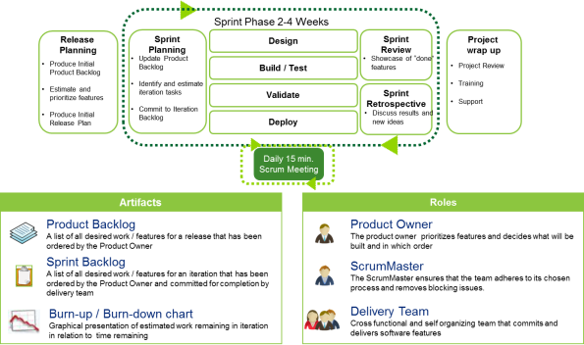
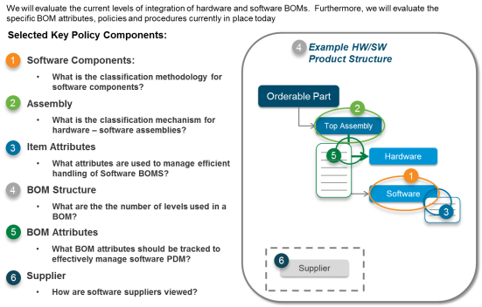
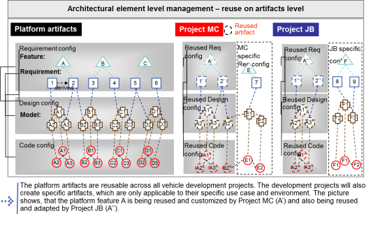
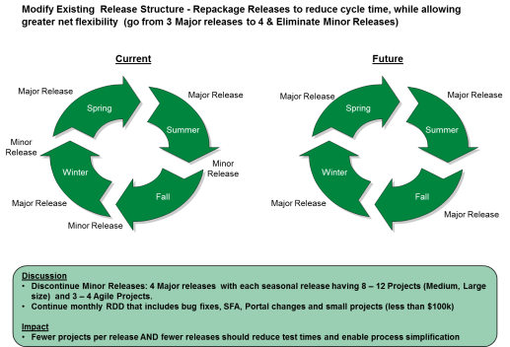
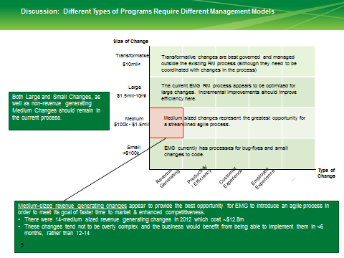
Step 2c: Assess Current State - Software Development Assessment
  Software Development Assessment will focus on the processes, practices and tools in place to partition, develop, configure and release software, and the integration points to hardware
Software development lifecycle and configuration management
Hardware-Software Integration
Software stacks, design
and reuse
Opportunities for incremental and transformative improvements in core development
Activities associated with this phase
Conduct a deep dive into SDLC and configuration mgmt processes
Evaluate the process for hardware-software integration
Evaluate the software framework and level of reuse
Identify root cause of process inefficiencies
Deliverables
Root cause of process inefficiencies
Opportunities for improvements

Slide 15
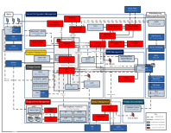
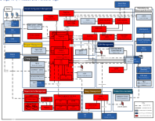
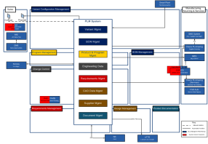
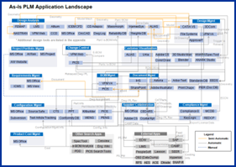
Step 2d: Assess Current State - Engineering IT Applications Assessment
  Clear understanding of current technology landscape is important to drive the future state technology transition plan – key to understand data flow and touch points.
Future state vision & goal
Future state technology roadmap
Phase - 1
Phase - 2
Final State
Analyze future state vision and goal’s impact on current state technology map.
Analyze how the current state can be simplified future state systems landscape by replacing multiple legacy PLM and ALM systems with enterprise-wide standard tools.
Current implemented technology
Activities associated with this phase
Determine & Document PLM Strategy
Map current tools used to manage the Engineering processes
Analyze the current tools landscape and recommend future state architecture to accomplish desirable efficiencies
Identify root cause of process inefficiencies
Deliverables
Documented PLM vision, strategy, and objectives
Identification of PLM gaps/issues /risks in relation to how other companies are successfully deploying PLM
Analyze the implemented technologies to create a clear assessment of data flow and system touch points.
Notes:
Put future state graphics from slide

Slide 16
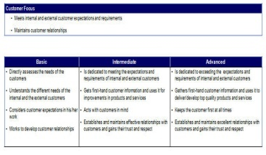
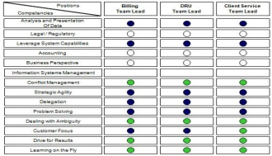
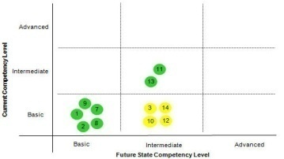
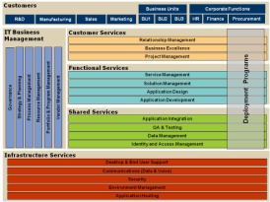
Step 2e: Assess Current State - Organizational Structure and Talent Management
  A clear understanding of the current organizational structure, governance, and the overall operating model for product development leads to developing options for the future state. Balancing flexibility and efficiency is critical in this exercise.
Governance
and leadership
Competency/Skills Model Definitions
Competency/Skills Model Role Requirements
Systems and
processes
Clearly
define roles
Organization
Strategy
Performance
metrics
Structure
Competency/Skills Model Gap Assessment
Operating Model
Regional Model by PBU
Global Model by PBU and OE
Vertical Global Model by OE
Activities associated with this phase
Assess the current competency models and broader talent management strategy
Assess the organizational structure, decision making and overall operating model
Deliverables
Gaps in competency and skills models, and talent management
Pros/Cons of current structure vs. alternatives
Root causes of inefficiency and key improvement areas
Corporate
Corporate
Corporate
E&S
E&S
E&S
ET
IDI
PT
ET
IDI
PT
ET
IDI
PT
LMS
NA
LMS
EOS
LMS
EOS
Europe
Competence
Competence
Services
Vendors
Vendors
PMO/HR
PMO/HR
Regionalized
Vertically Aligned
Notes:
Put future state graphics from slide

Slide 17
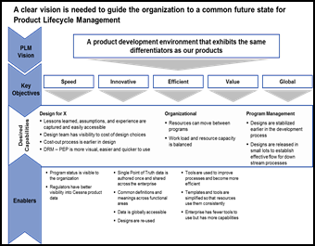
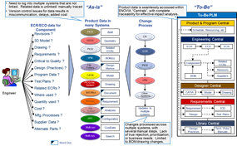
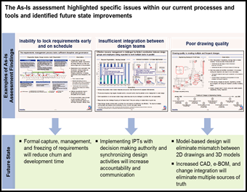
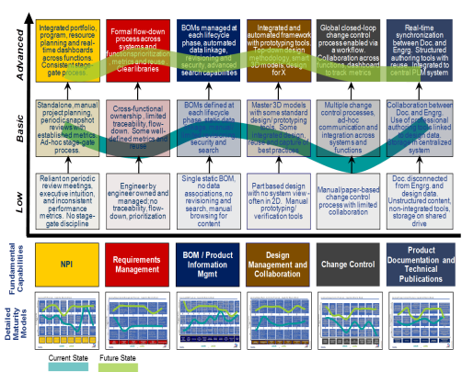
Step 3: Define Future State
  Based on vision, objectives and assessments define improvement initiatives, recommendations and future state process/technology map to close the gap between as-is and to-be state.
Vision & Objectives
Initiatives & Recommendation
Future State Process, Technology and Organizational Maps
Current State Assessments
Activities associated with this phase
Identify gaps based on value stream mapping and maturity assessment
Define recommendations to close identified gaps
Determine how to apply recommendations to key process and technology enablers
Deliverables
Prioritized recommendation list for process and PLM improvements
Future state concepts – Process, Technology and Organization

Slide 18

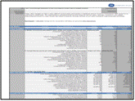
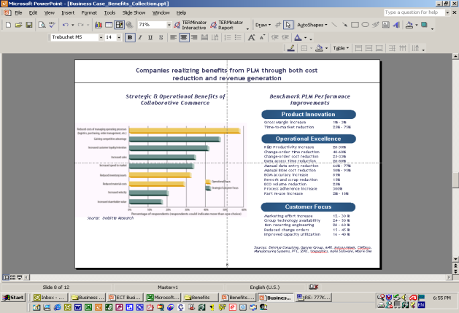
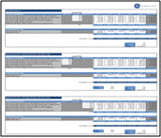
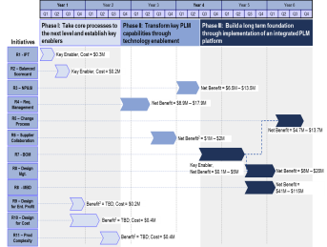
Step 4: Build Roadmap and Business Case
  The assessment phase of the project culminates into a detailed roadmap and business case that identifies the quantitative and qualitative benefits of the improvement initiatives.
Identify
Define & Validate
Refine
Analyze
Identify Improvement opportunities
Define baseline for improvement opportunities
Sequence improvement benefits to roadmap
Extrapolate benefits across all programs
Validate benefits with Functional SMEs and Stakeholders
Refine by comparing against industry benchmarks
Use conservative benchmarks to leave potential upside
Eliminate double counting and refined benefit calculations with feedback from functional SMEs
Enter benefits into Financial Impact Template to analyze benefits and document assumptions
Determine ROI
Roadmap
Business Case
Activities associated with this phase
Quantify the business case benefits for each recommendation
Prioritize and sequence recommendations based upon dependencies and value to the organization
Finalize business case and validate with leadership and key stakeholders
Validate roadmap with leadership and key stakeholders
Deliverables
Business Case
Multi-phase roadmap
Executive presentation
The roadmap provides a multiyear plan to develop the process, people, and supporting infrastructure required to achieve PLM vision
Costs and benefits of each detailed recommendation are calculated to determine the total ROI

Slide 19
Approach - Improvement Phase

Slide 20
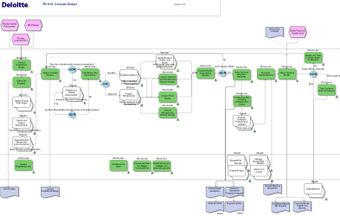
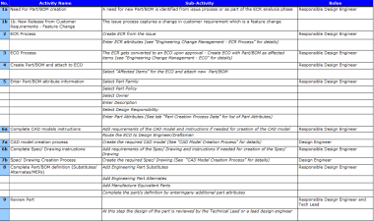
Following the assessment, we help our clients execute their transformation roadmap by using our proven tools and accelerators
  We have developed a very integrated set of tools that are Teamcenter specific end-to-end Business Process Models from Requirements, BOM, Change, Documents Mgt. through Manufacturing Planning BOM Release
Level 1 and Level 2 Process Maps
Level 3 Process Maps
Level 4 Sub activity and roles maps
Engineering and PLM Best Practices Compilation
Pre-defined set of unit, functional and integration testing scripts
Detail Business Process & PLM requirements
Conference Room Pilot “In-a-Box”
Pre-defined Training Materials

Slide 21
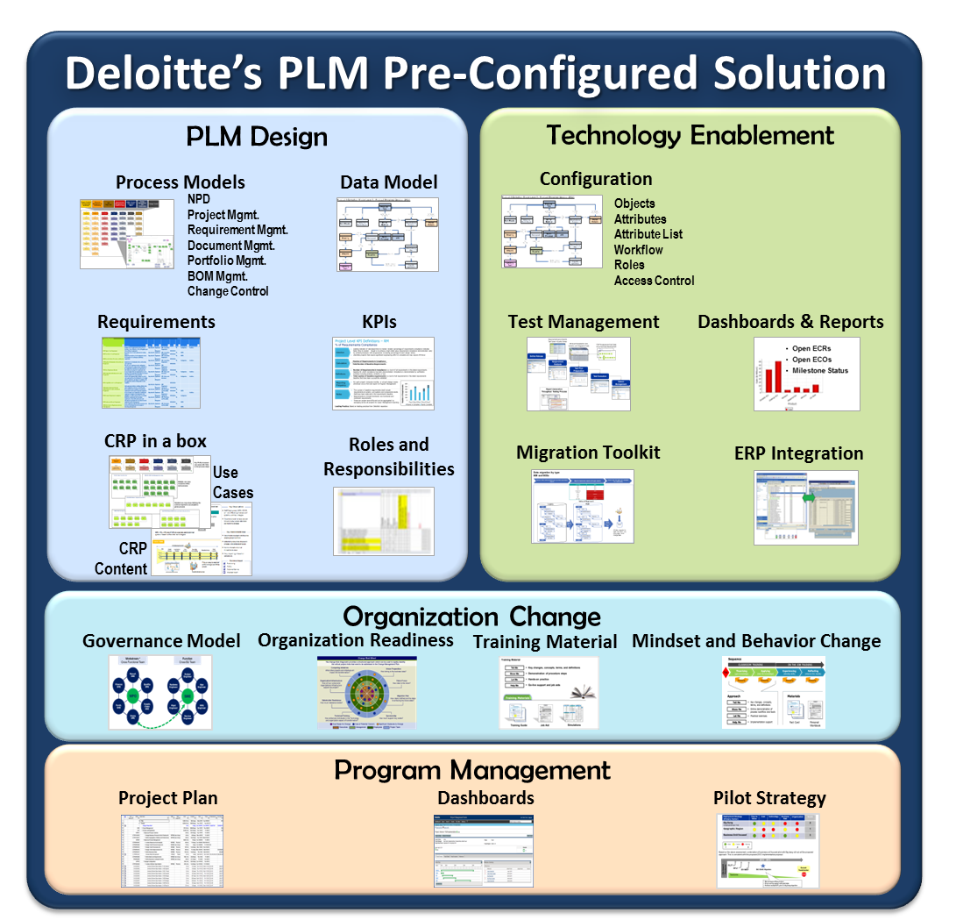
What is Deloitte’s PLM (DPLM) Pre-Configured Solution?
  DPLM is an “out-of-the-box” Pre-Configured Solution which is based on Deloitte’s deep experience in lean engineering, industry, process design, technology enablement, organizational change, and program management.

Slide 22
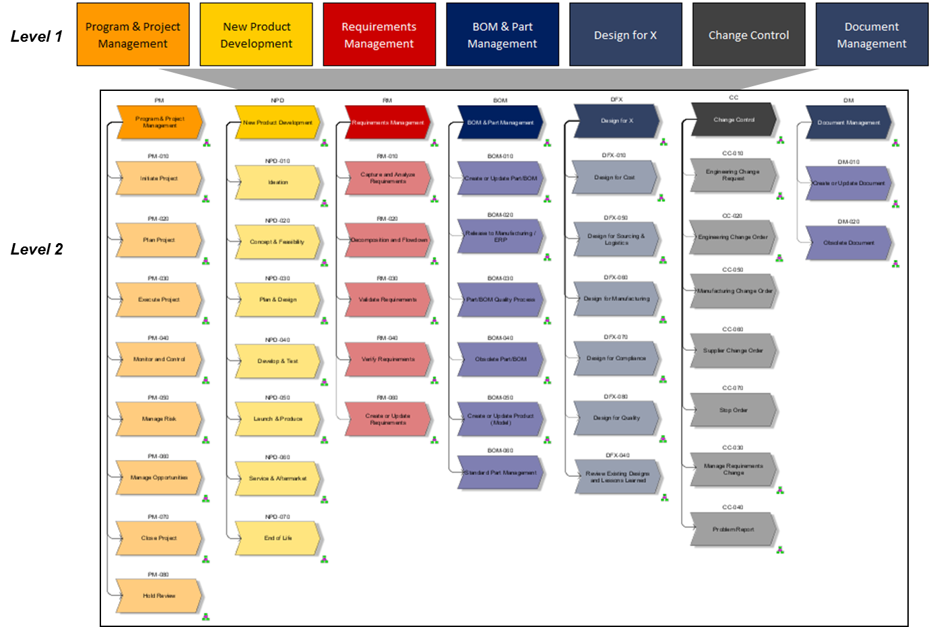
Our process maps incorporate Deloitte’s lean engineering best practices and include all major PLM processes to accelerate blueprinting
Deloitte’s Pre-defined PLM Processes

Slide 23
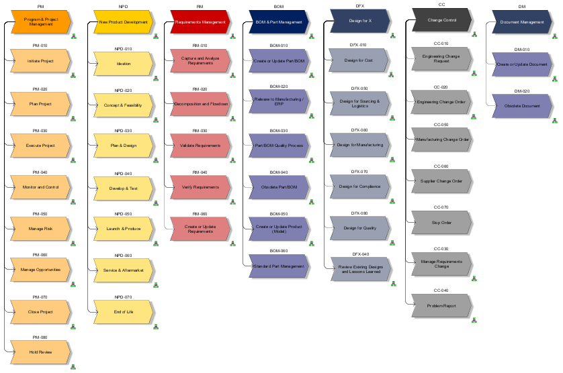
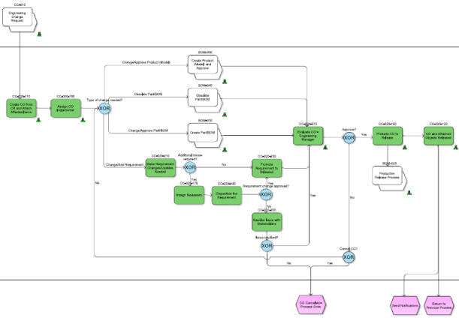
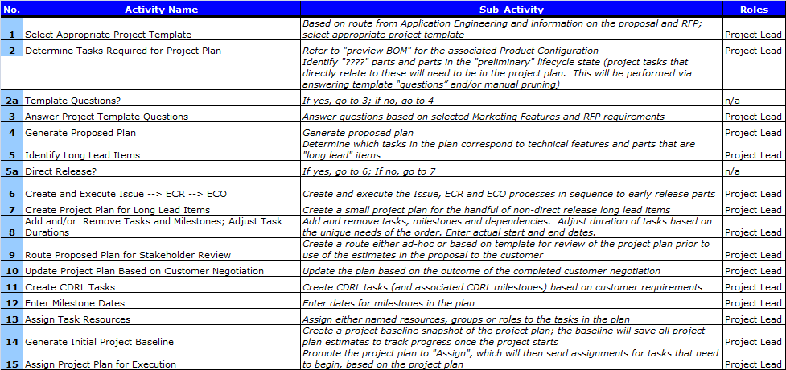
Blueprinting maps lower the levels of detail to activity maps, use cases, and PLM activities
Deloitte PLM Process Models – Level 1 – 4 Decomposition
Level 1
Activity Map (Level 3)
Level 2 & 3
Sub-activities/Roles (Level 4)
Level 4
Process Details
Process Details
Process Details
Process Details
Process Details
Process Details
Process Details
Roles & Resp.
Roles & Resp.
Roles & Resp.
Roles & Resp.
Roles & Resp.
Roles & Resp.
Roles & Resp.
Roles, Responsibilities, Metrics & Templates
Metrics &
Dashboard
Metrics &
Dashboard
Metrics &
Dashboard
Metrics &
Dashboard
Metrics &
Dashboard
Metrics &
Dashboard
Metrics &
Dashboard
Templates
Templates
Templates
Templates
Templates
Templates
Templates
Design Decisions & DPLM Req’s
Key Design Decisions
DPLM Process and Technical Requirements

Slide 24


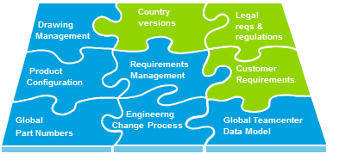

DPLM is designed to help clients utilize our pre-defined PLM processes in an “Out of the Box” method where processes are standardize and mapped to 3DEversus customized.
Validate
User Acceptance
Training
As we looked across the processes, methods and tools we develop for out clients, ~80% of the core was largely similar
We created DPLM that comes “out-of-the-box” with the 80% that captures best practices – across lean processes, configuration and training
This allows our PLM experts to focus their attention on 20% that is truly unique to the client, as well as on integration to existing business processes
This 20% is where companies get the strategic/competitive advantage
Provide clients with a ‘ready to use’ environment to feel and play with the future state processes
Improve & Iterate
Configure and develop system configuration and interfaces
Iterate To-Be Process & Tool
Conference Room Pilot #3
Initiate & Integrate
DPLM Processes & Configuration
Identify client-specific ‘Must Haves’
Challenge region/BU process deviations
Identify integration to other client processes
Conference Room Pilot #1 & #2
User Buy-In and Adoption
Assess
As-Is Deep Dive
DPLM (80%)
Unique(20%)

Slide 25


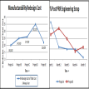

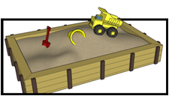
DPLM offers efficient and cost-effective PLM transformation for our clients
30 % shorter implementation time
40% lower implementation cost
15% higher engineering efficiency
Reduced PLM program risk and risk of customization
Ability to see PLM processes from Day 1 that have deep Lean Engineering and Best Practices embedded

Slide 26
Q & A

